Slide 1
Mark Ackley, Waimea, HI

Slide 3
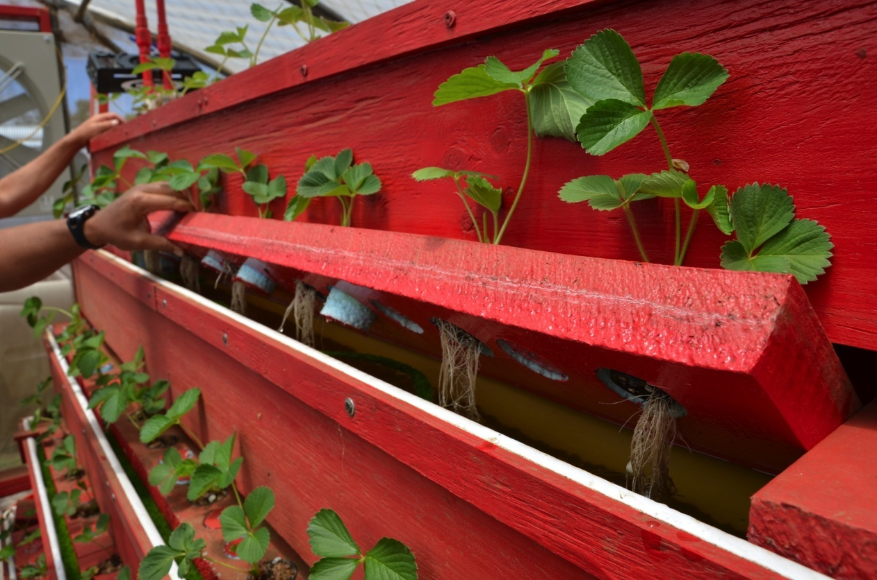
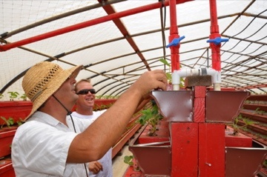
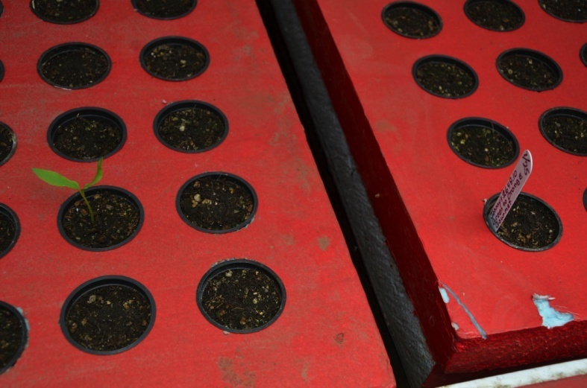

Slide 4
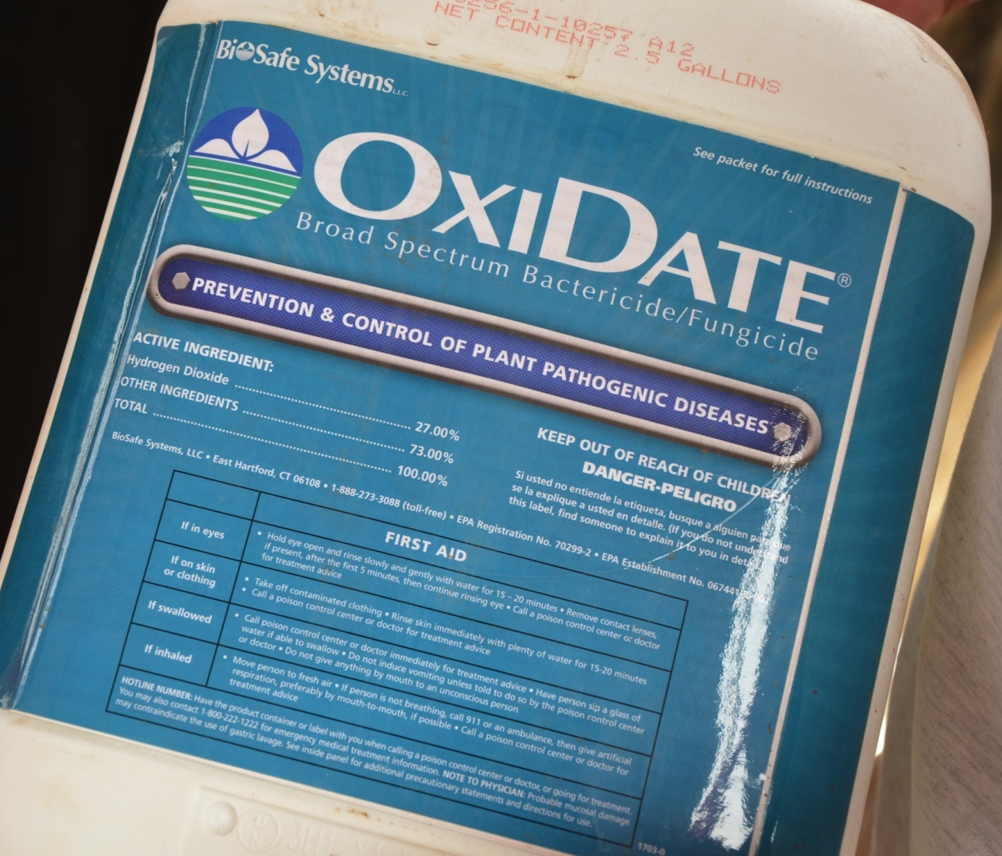
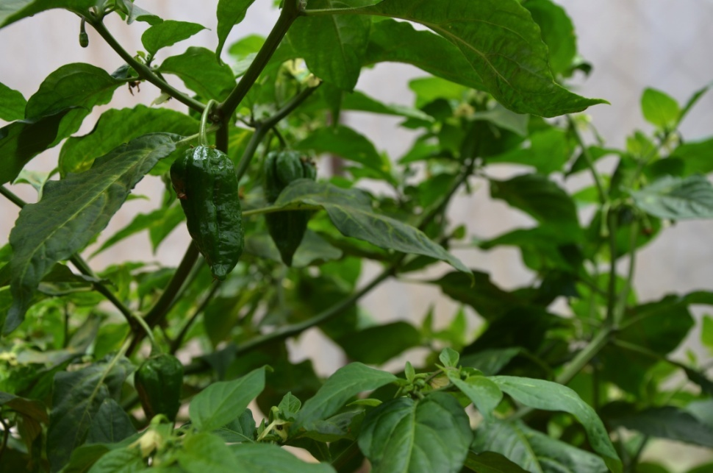

Slide 5
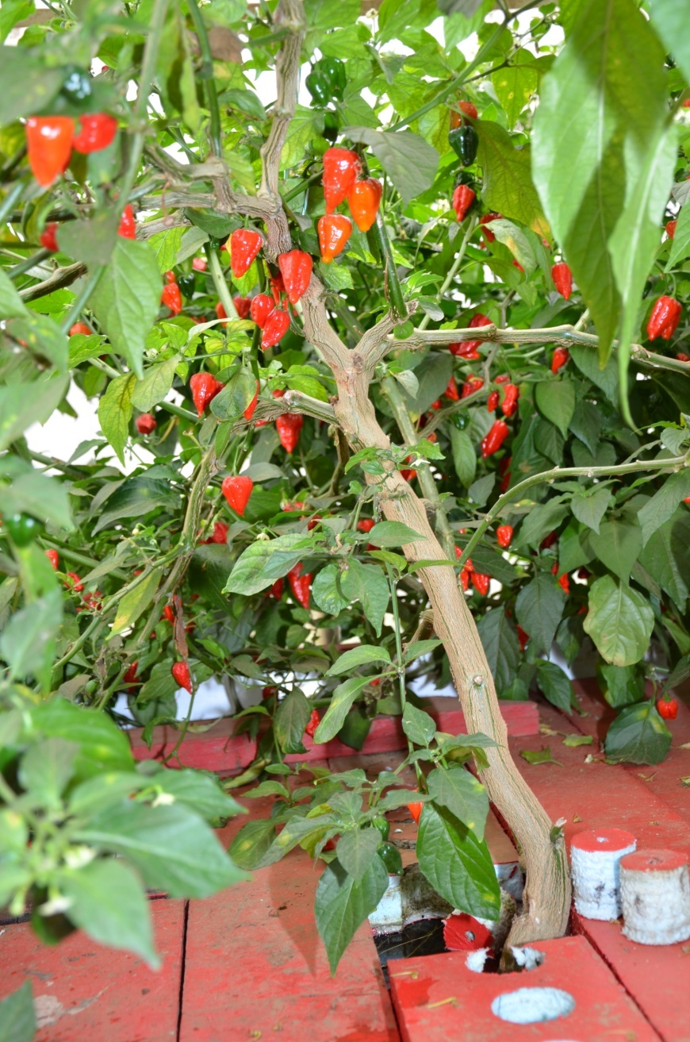

Slide 6
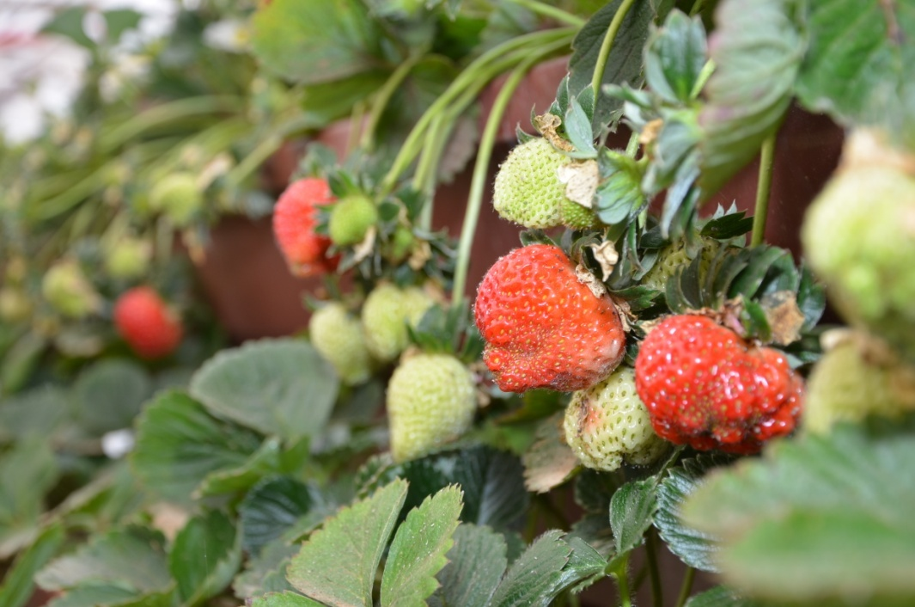

Slide 7
Mark’s Numbers:
Started with a rented greenhouse, spent $100,000 over the next two years experimenting with strawberries, green onions, and Thai Ghost Peppers.
His partner killed 800 pounds of fish once by spraying their plants for three months with a detergent insecticide spray.
In another “experiment” they put 1 gallon a week of Effective MicroOrganisms (EM) into their system for 4 weeks, all plants got black roots and died. They killed all their strawberries a total of 3 times.
Mark had figured out how to grow strawberries commercially, but needed to get “divorced” from his partner and shut down the farm as the only way to get out of a bad business entanglement.
Was this a success?

Slide 8
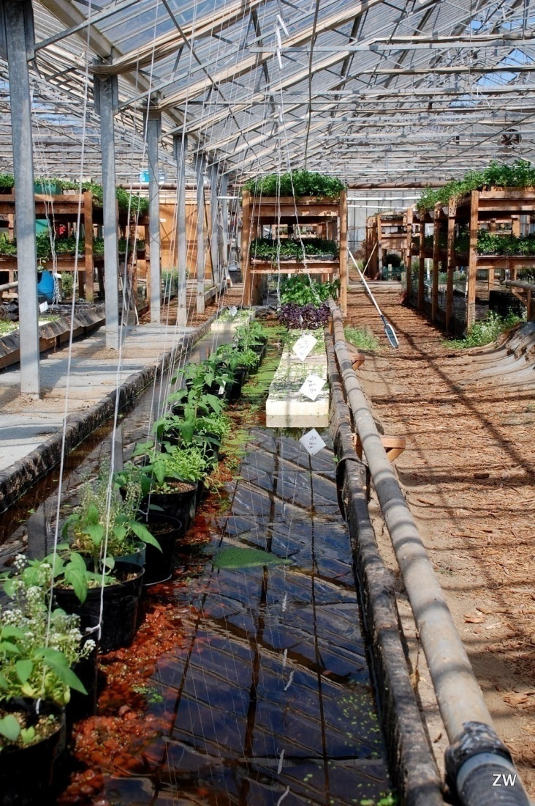
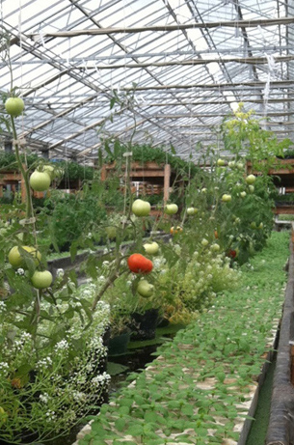
Santa Cruz Aquaponics

Slide 9
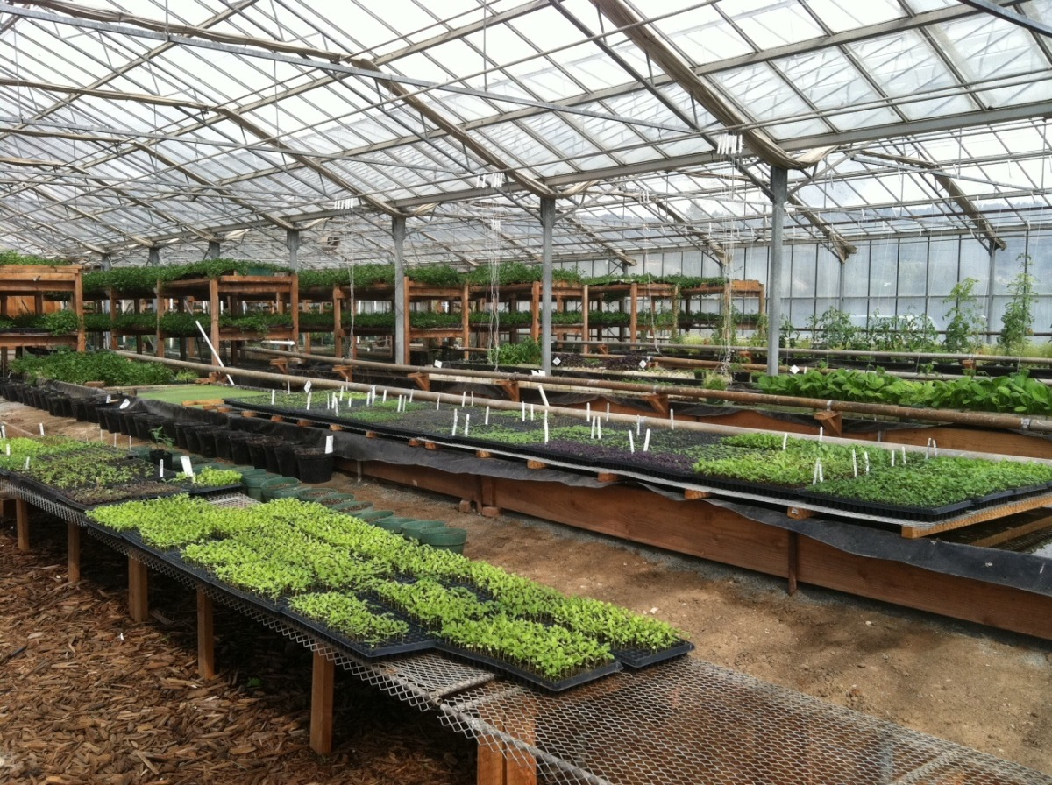
Santa Cruz Aquaponics

Slide 10
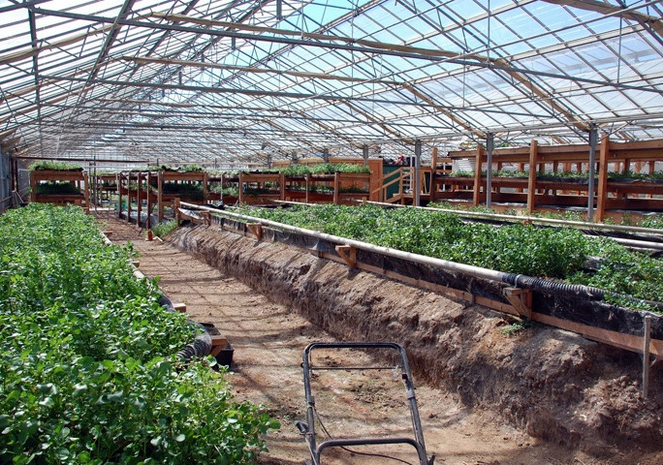
Santa Cruz Aquaponics

Slide 11
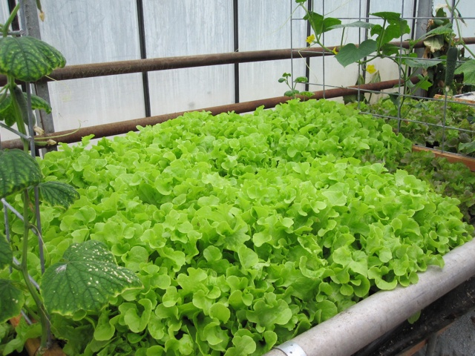
Santa Cruz Aquaponics

Slide 12
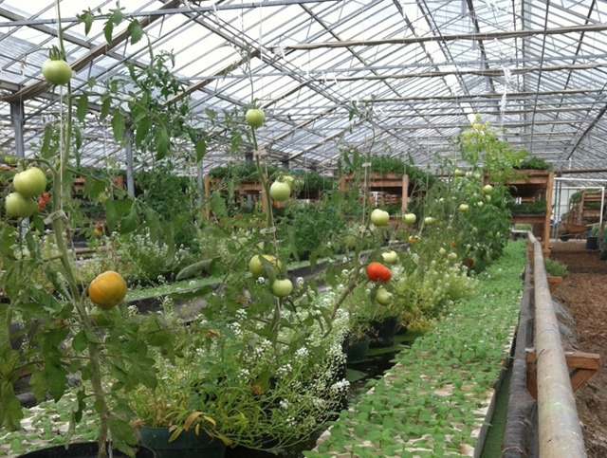
Santa Cruz Aquaponics

Slide 13
Santa Cruz Aquaponic’s Numbers:
$350,000 invested in this operation (internet gossip)
Started with a greenhouse that cost (???). Holds a total of (???) plants. (???) organically certifiable.
Maximum possible yearly income: (???)
Estimated yearly consumables expenses, NOT including labor, debt service, or overhead: (???)
Copied “non-commercial” Growing Power technology.
Video says tilapia, but tilapia illegal. (Whose idea was that?)
Is there ANY way this could possibly be a success?
We don’t know. Don’t know what happened, who did what, how much they got right, how much they got wrong. They’re gone, just like the dinosaur and the dodo.

Slide 14
Green Sky Growers

Slide 15
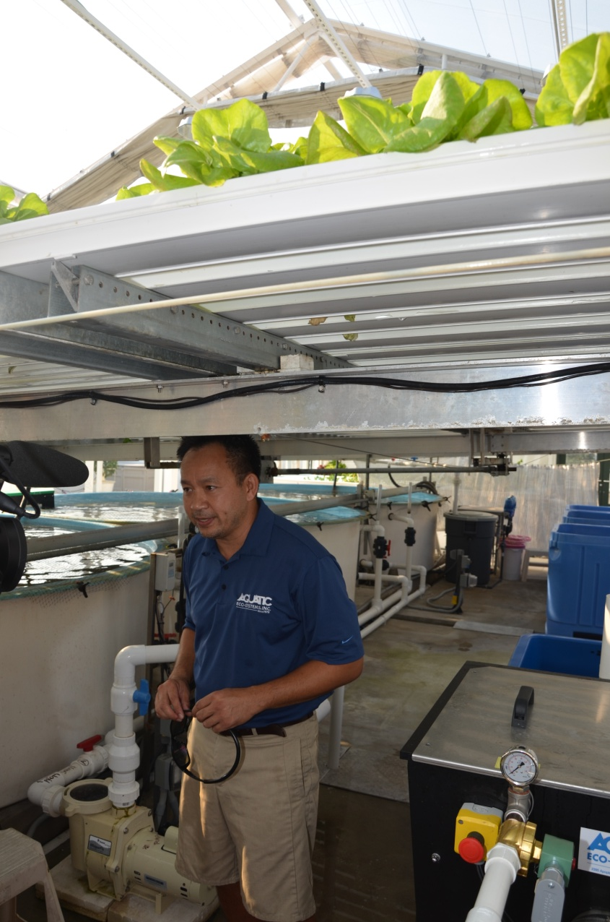
NFT

Slide 16
Aquaponics….

Slide 17
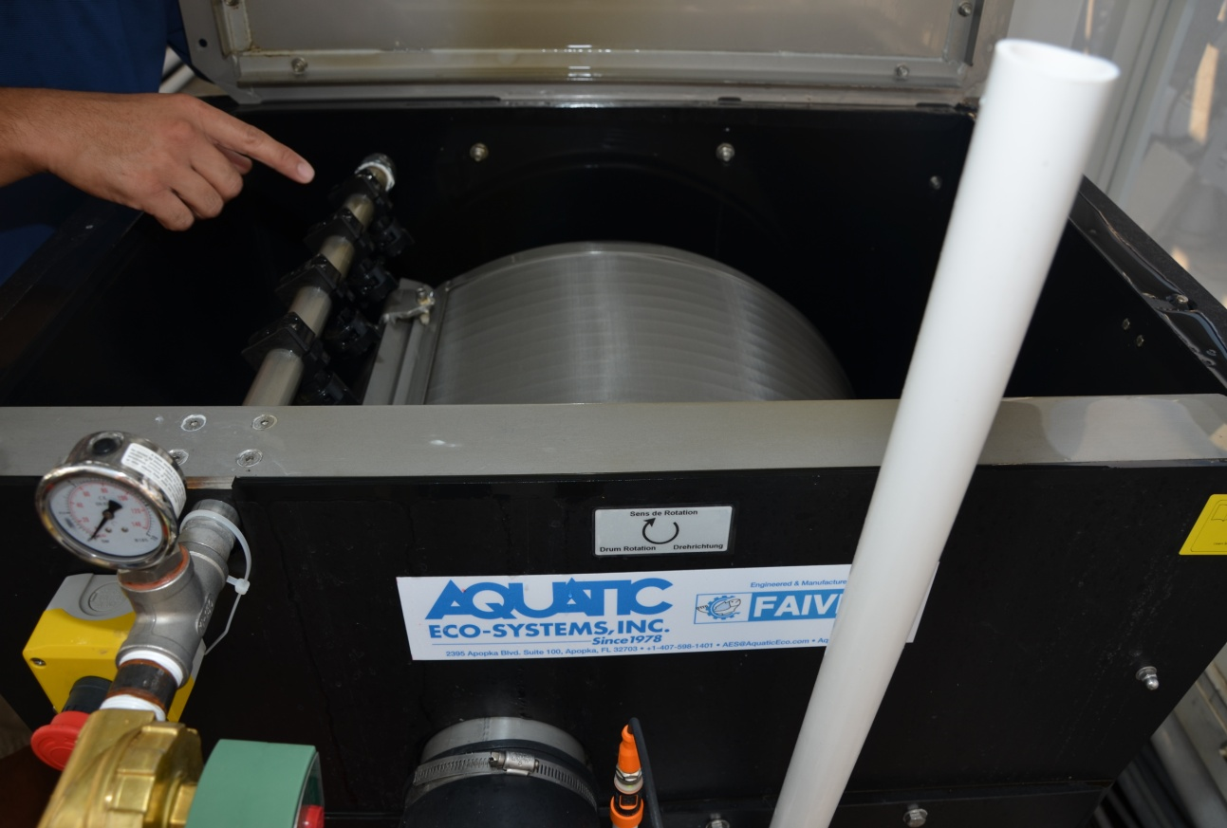
…sort of!

Slide 18
Koi

Slide 19
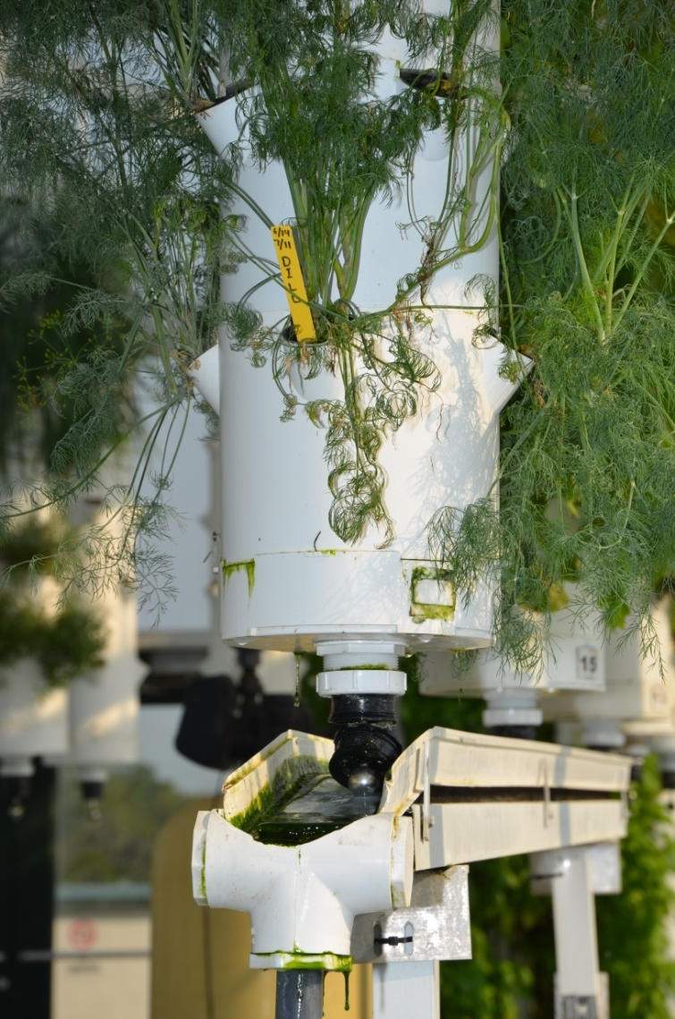
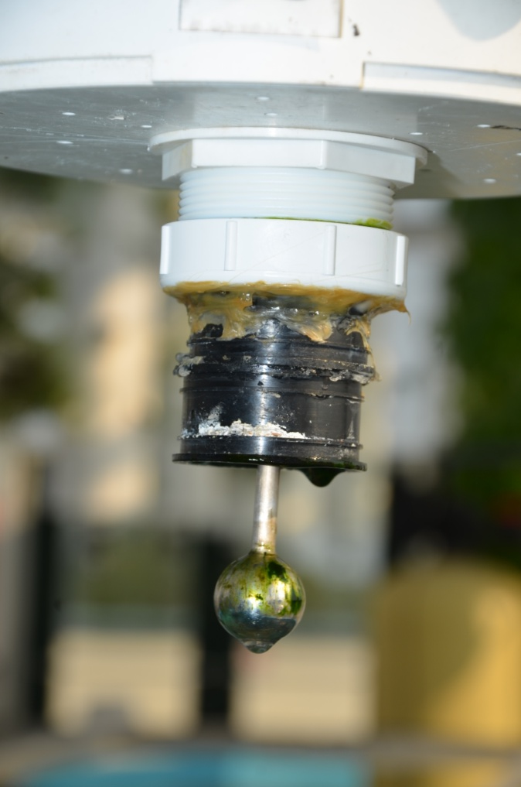
Vertical

Slide 20
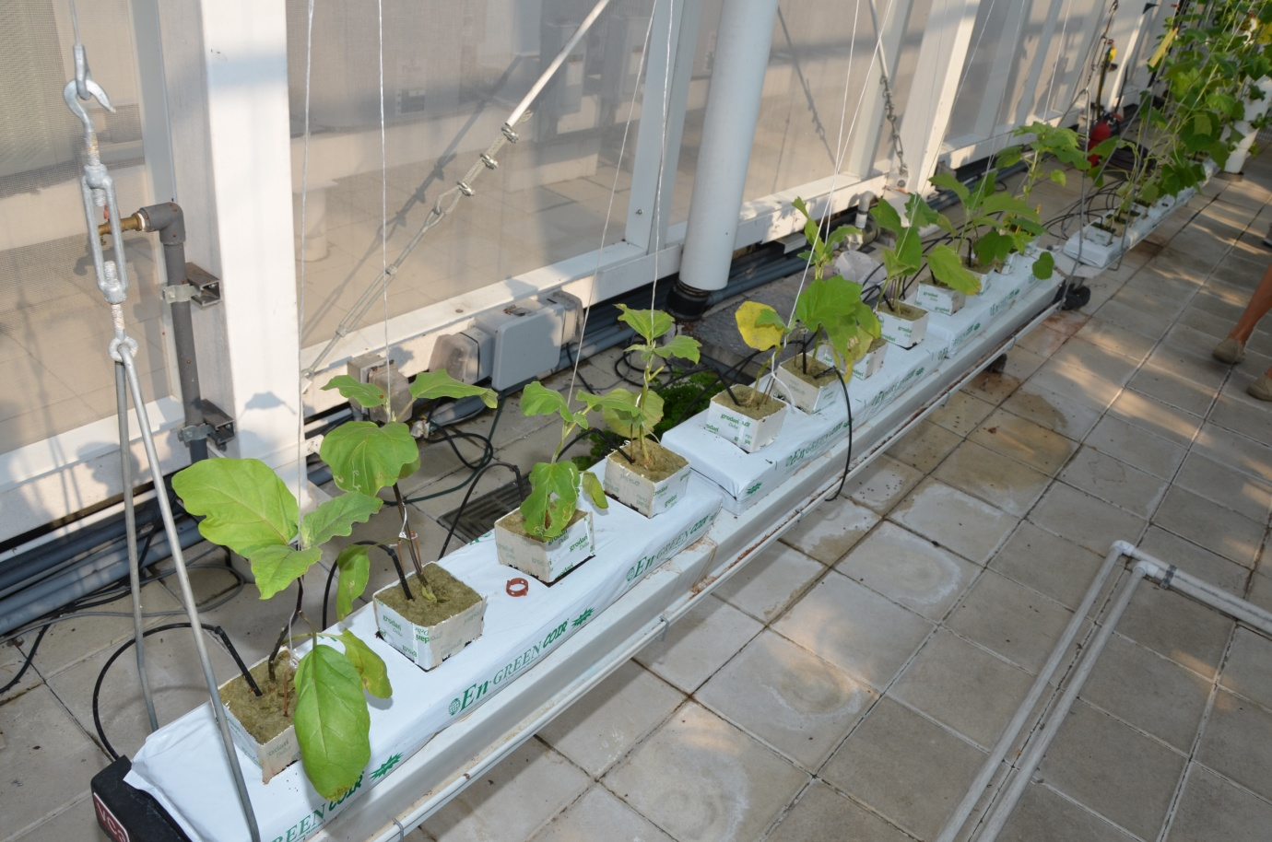

Slide 22
Green Sky’s Numbers:
Started with a greenhouse that cost $1.5 million. Holds a total of 748 plants. Not organically certifiable.
Maximum possible yearly income: $7,750
Estimated yearly consumables expenses for fish food, electricity, hydroponics nutrients, seeds and potting mix; but NOT including labor, debt service, maintenance and repairs, or overhead: $24,924
Is there ANY way this could possibly be a success?
Yes! But only for the equipment providers: sell “Commercial Aquaponics” trainings to people who then buy lots of STUFF to make systems like this one!

Slide 23
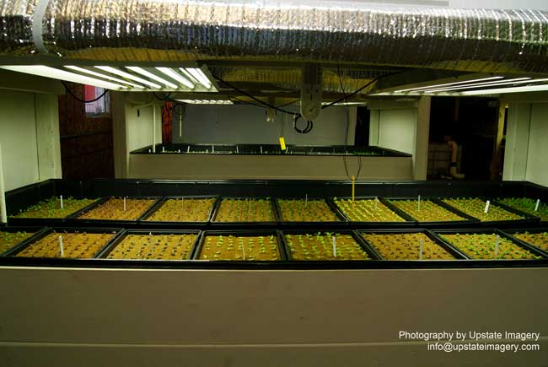
Aqua Vita Farms

Slide 24
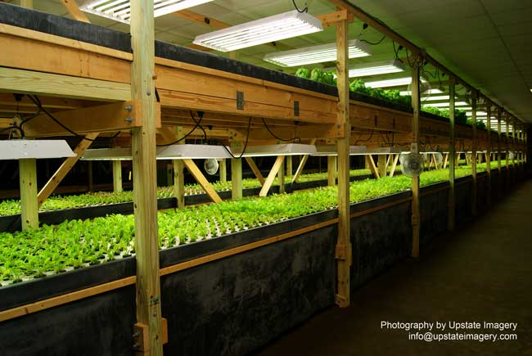
Aqua Vita Farms

Slide 25
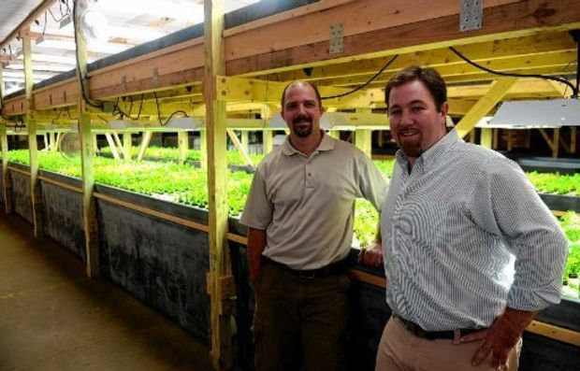
Aqua Vita Farms

Slide 26
Aqua Vita’s Numbers:
Started with a $500,000 debt, $200,000 not forgivable loan from the USDA, guaranteed by a local bank. Not organically certifiable.
Maximum possible yearly income: $????
Estimated yearly consumables expenses, NOT including labor, debt service, or overhead: $?????
Locked into buying electricity, whatever the cost.
“Looking for investors” after one year, closed after two years; finally, “selling off assets”. Was this a success?
NO. The poor guy lost his house, his credit, and will be paying for this for a long time.

Slide 27
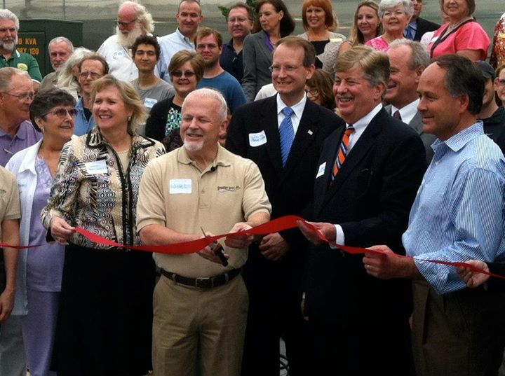
Greater Growth, LLC

Slide 28
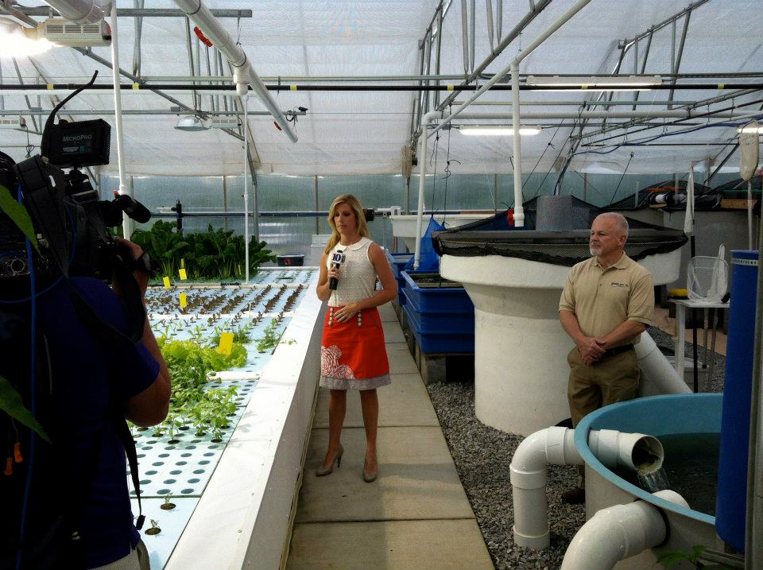
Greater Growth, LLC

Slide 29
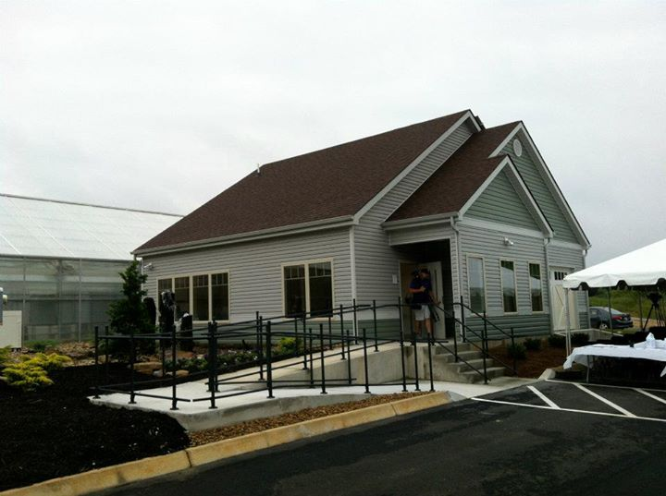
Greater Growth, LLC

Slide 30
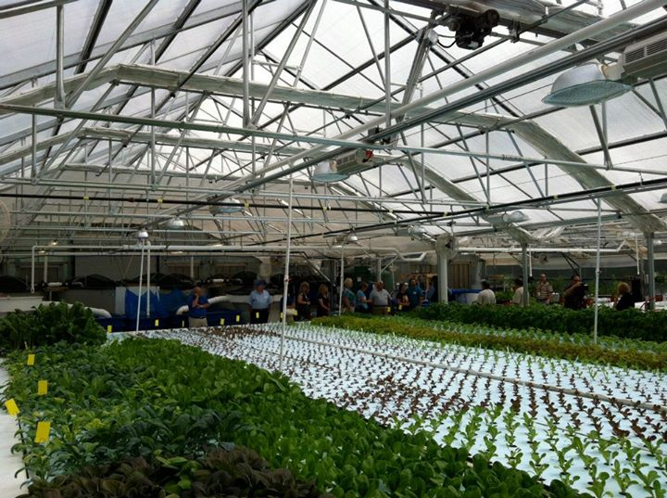
Greater Growth, LLC

Slide 31
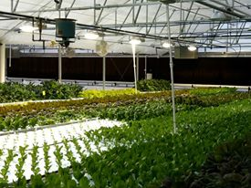
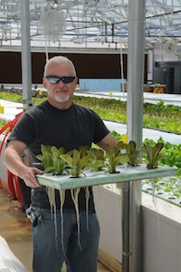
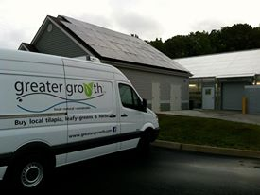
Greater Growth, LLC

Slide 32
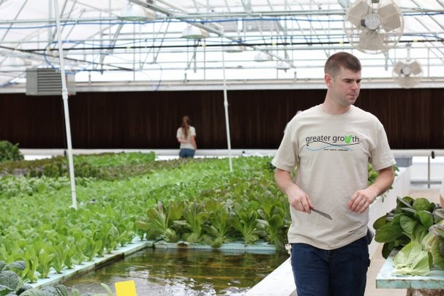
Greater Growth, LLC

Slide 33
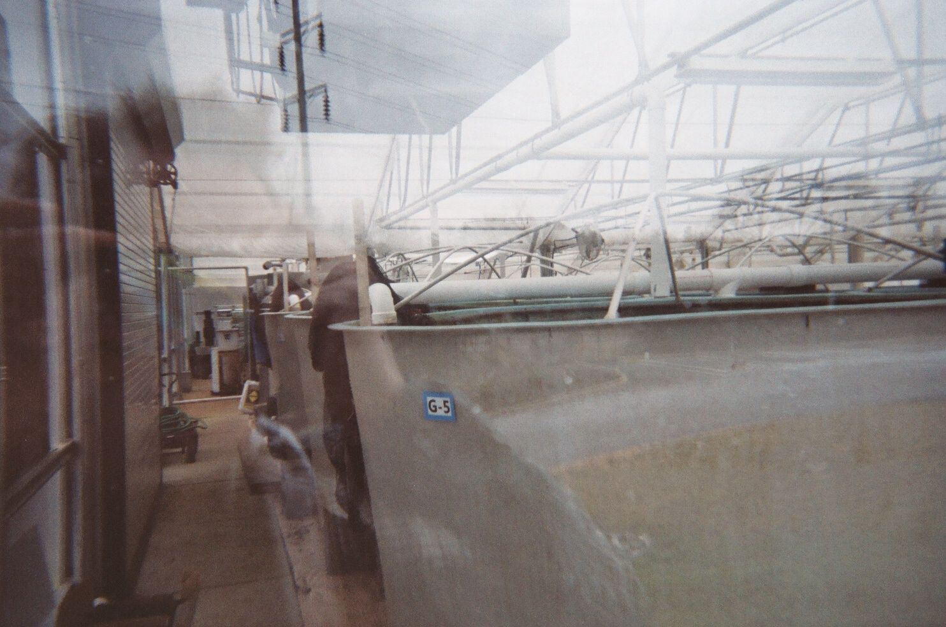
Greater Growth, LLC

Slide 34
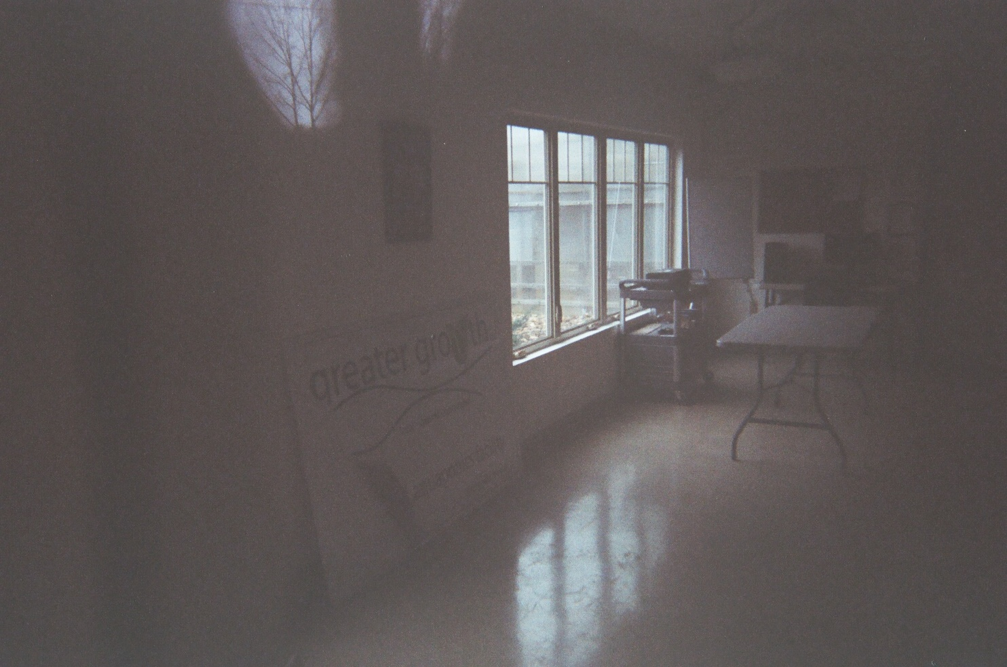
Greater Growth, LLC

Slide 35
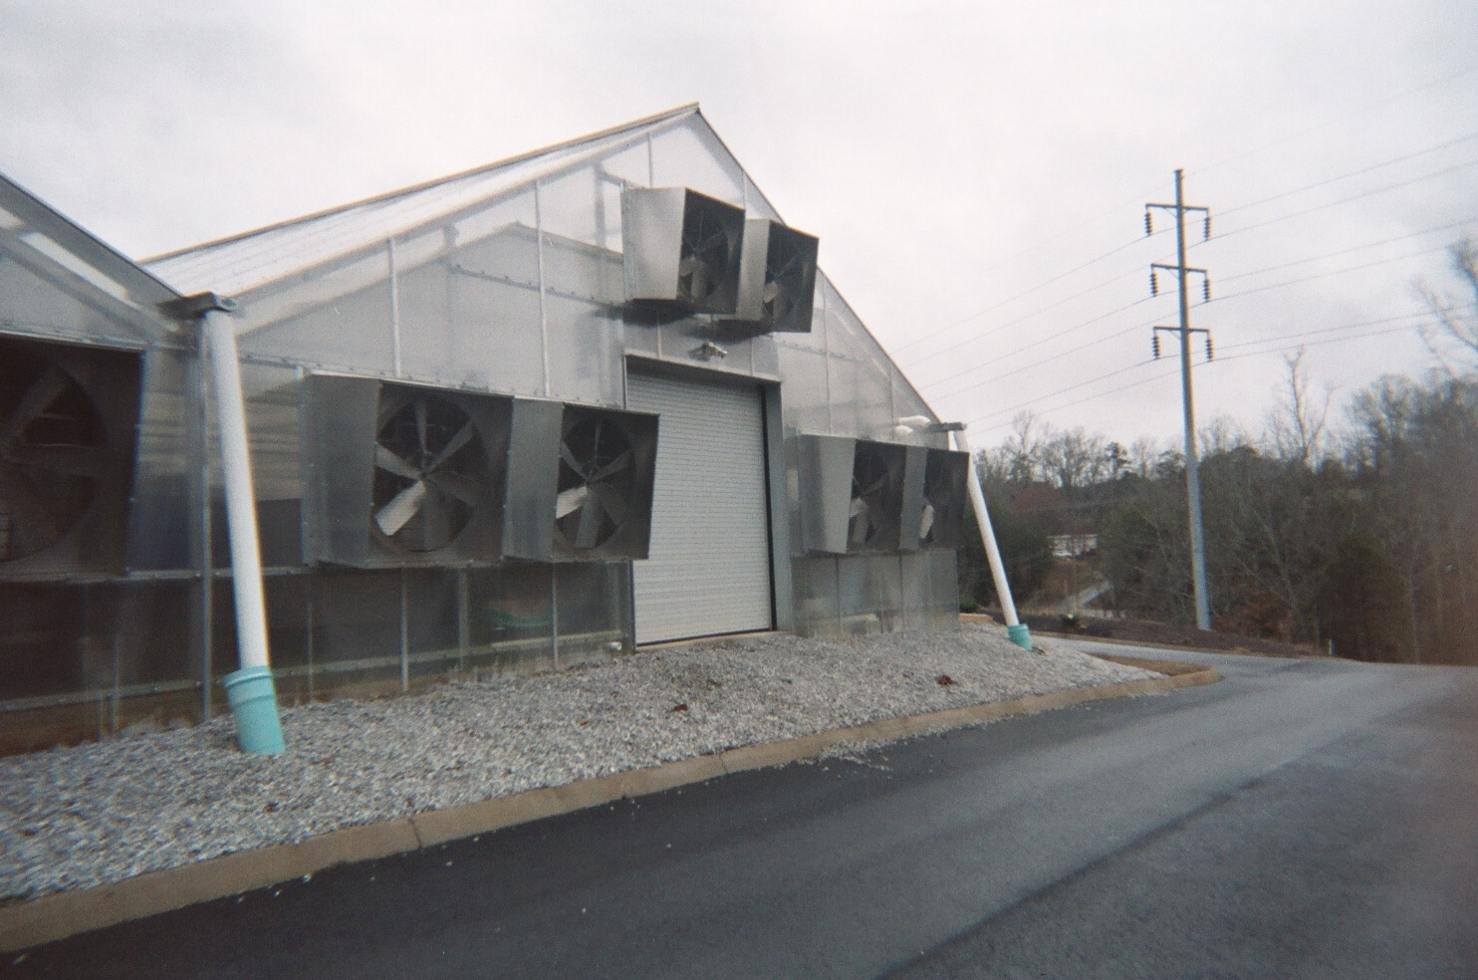
Greater Growth, LLC

Slide 36
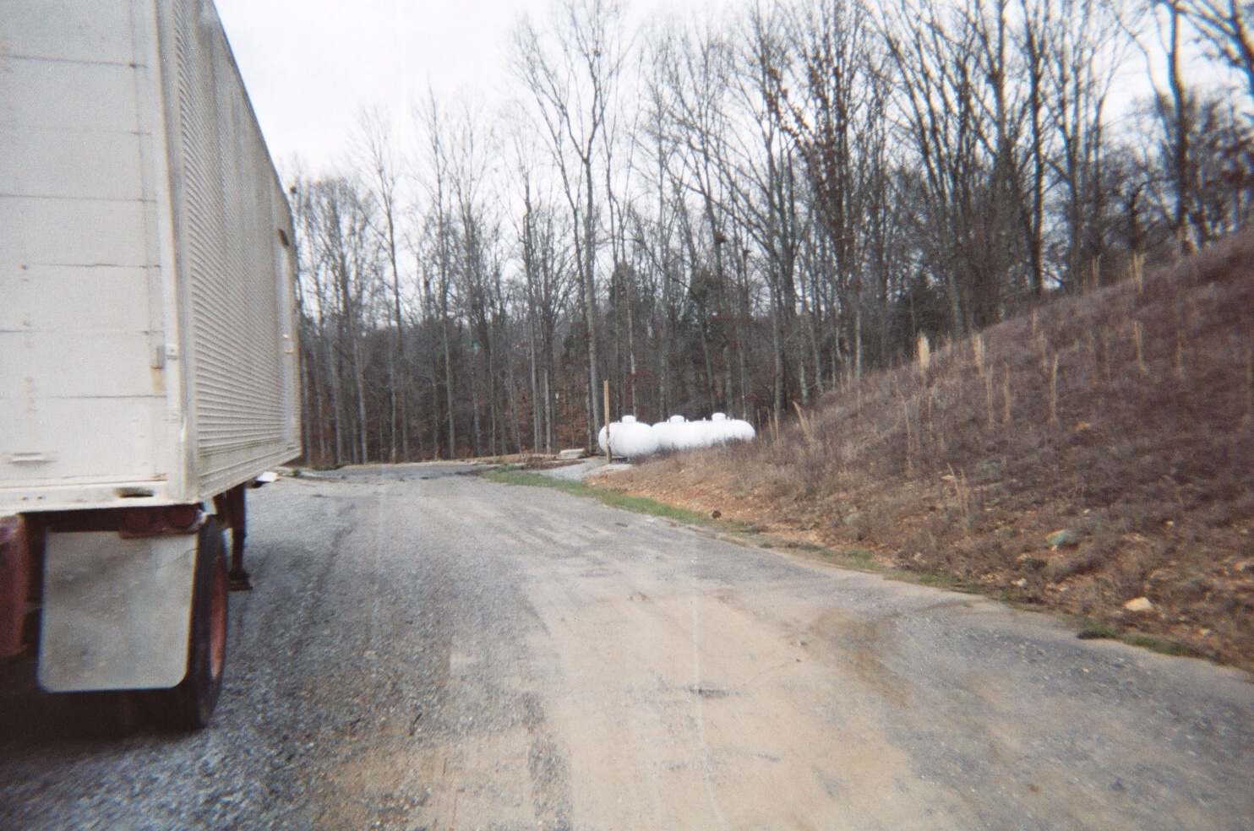
Greater Growth, LLC

Slide 37
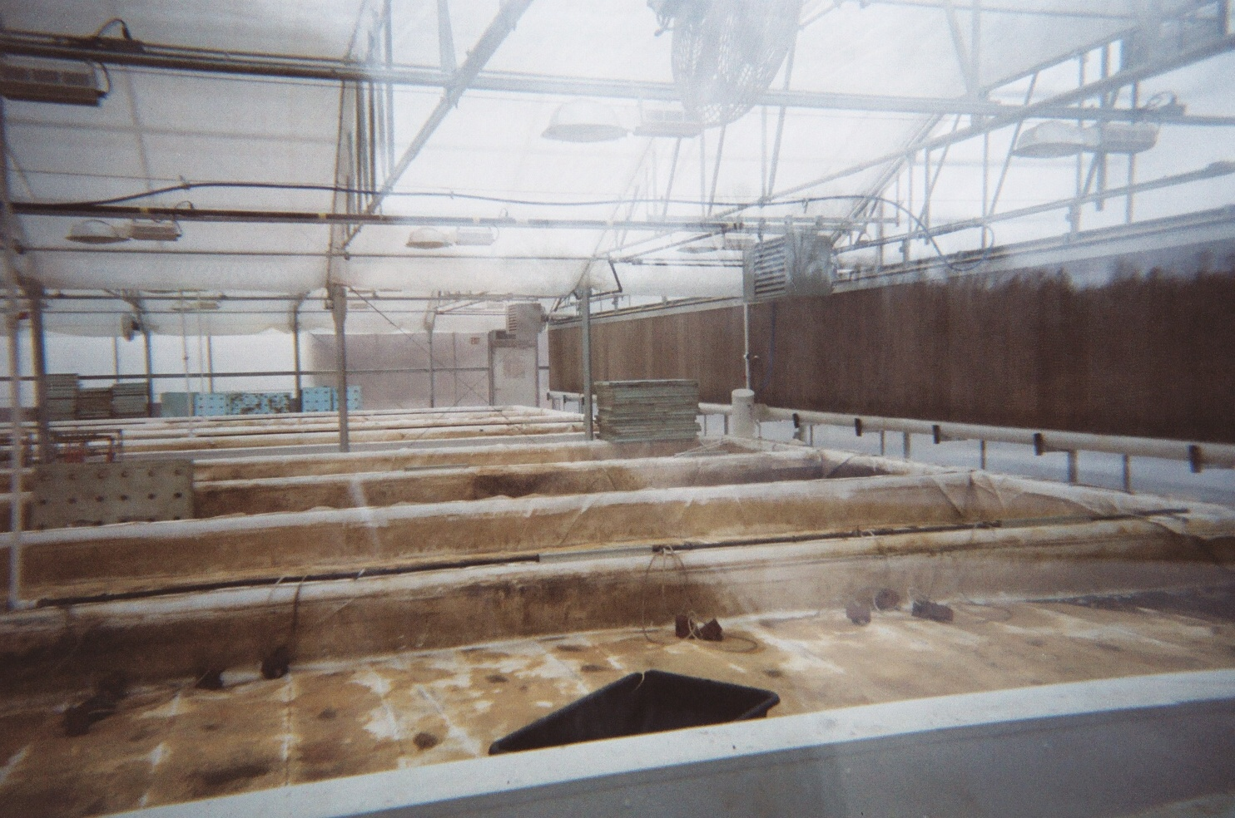
Greater Growth, LLC

Slide 38
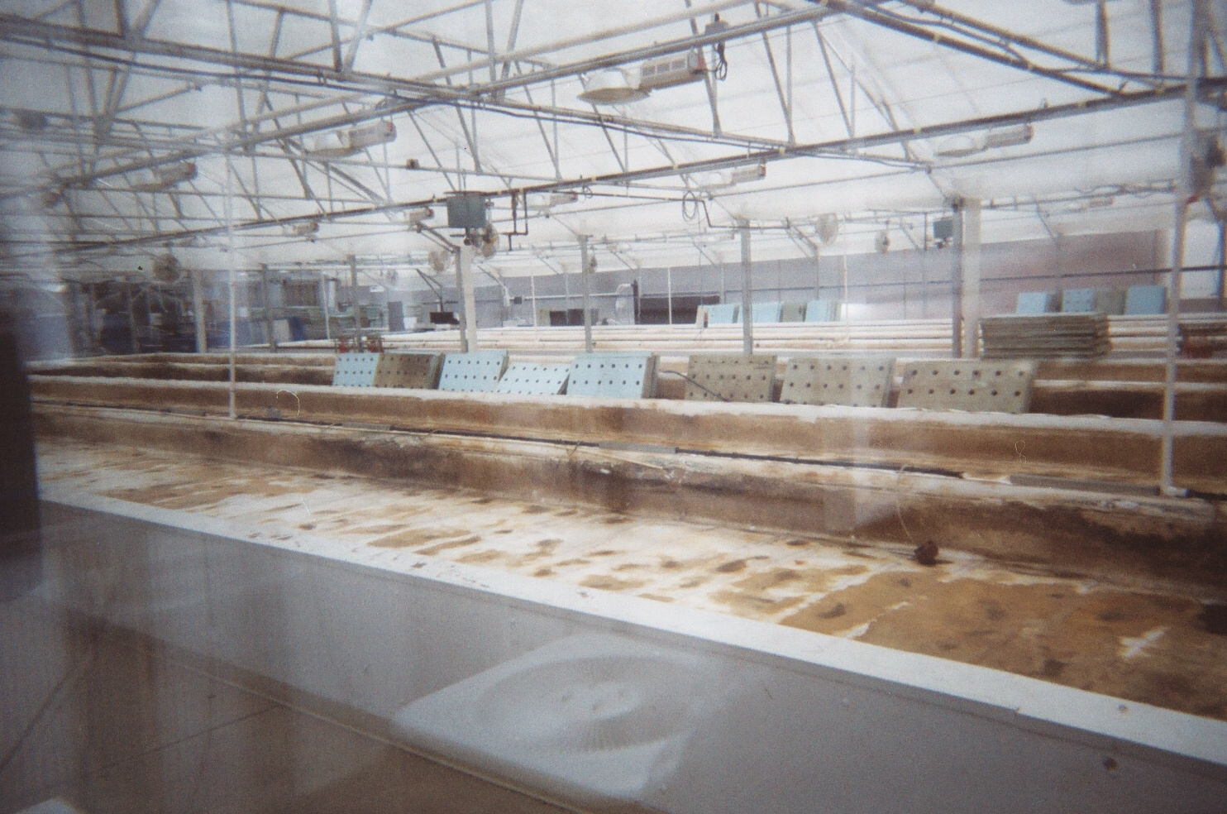
Greater Growth, LLC

Slide 39
Greater Growth’s Numbers:
Started with a greenhouse that cost $1.4 million. Got organic certification. Had solar panels on the roof.
Held one “Commercial Aquaponics” course in June 2012 with UVI professor teaching
Foreclosed in October 2012.
Possible yearly gross: $72,000 to $144,000
Estimated yearly consumables and labor expenses: $60,000 to $96,000.
Estimated yearly debt service: $144,000 to $174,000
Is there ANY way this could be a success?
Yes! Buy it at the foreclosure auction for $200,000, then reconfigure rafts to Friendly design = 3 times as many plants, and one-sixth the expense.

Slide 40
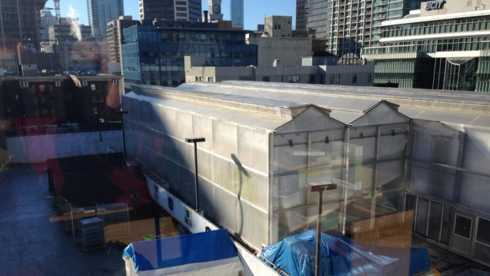
Alterrus and Local Garden Vancouver

Slide 41
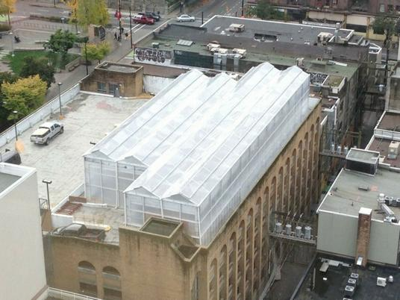
Alterrus and Local Garden Vancouver

Slide 42
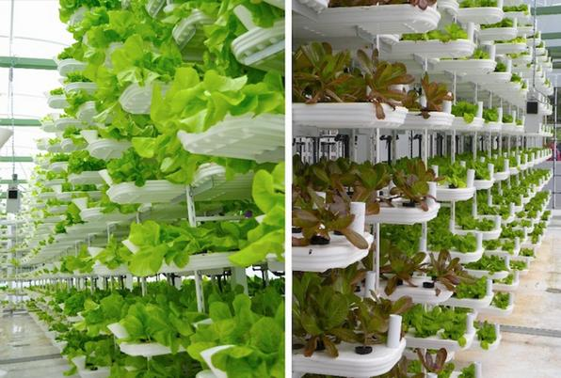
Alterrus and Local Garden Vancouver

Slide 43
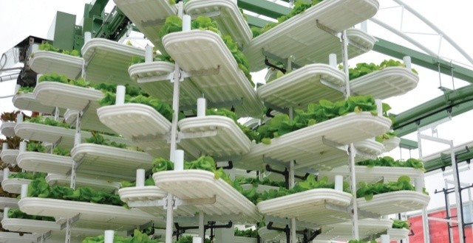
Alterrus and Local Garden Vancouver
Using “VertiCrop” Patented Technology

Slide 44
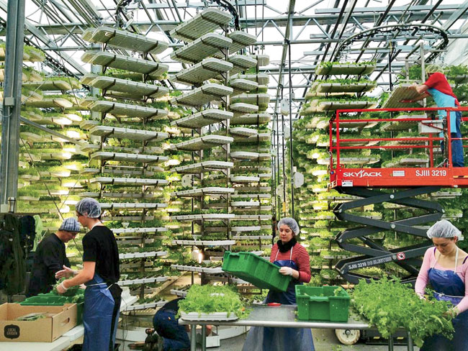
Alterrus and Local Garden Vancouver

Slide 45
Alterrus and Local Garden Vancouver’s Numbers:
Started with a beautiful greenhouse and patented vertical growing system that cost $4 million.
Started operation in November 2012, entered bankruptcy in January 2014, for a total of 13 months in operation.
Complete articles detailing the situation here: (http://www.montrealgazette.com/business/Failure+high+tech+rooftop+greenhouse+Vancouver+leaves+million+trail+debt/9437263/story.html)
And here: (http://www.vancitybuzz.com/2014/01/downtown-vancouvers-rooftop-garden-closes-files-bankruptcy/)

Slide 46
Alterrus and Local Garden Vancouver Failure Analysis:
What They Said:
What It Means:
The Companies, Alterrus Systems Inc. and Local Garden Vancouver Inc. on a consolidated basis, have been challenged with working capital issues for the past months. This combined with productivity challenges on the leafy green side of crop production led us to change focus to the micro-greens crop which represented lower operating cost and higher margins overall. The micro-greens market potential was one which required development and although headed towards the positive cash flow direction it was moderately slow getting there.
A number of capital infusion opportunities were pursued in the last two quarters and were positive enough to lead us to believe they were impending and could tide us over to a point where a planned TSX fund raise was possible. We strategically converted significant amounts of debt to shares recently to strengthen the company’s balance sheet.
A few repayment agreements negotiated earlier in the year with creditors became due in October/ November which could not be immediately satisfied and demand notices were considered to be imminent.
In October/November we approached our Bank for a bulge in the operating line to seek relief. This request was respectfully declined but a deferral of principal and interest payments were offered through March 2014 to assist.
Severe cost cutting across all facets of greenhouse operations and G&A was implemented with success and beginning to reflect in our P+L.
A significant mechanical failure experienced in late December 2013 impaired our ability to safely and effectively operate was precipitous to the fateful decision by the board to enter into an assignment to Trustees of bankruptcy on Jan 21st, 2014. Effective on this date the affairs of the Companies were taken over by The Bowra Group.
We needed working capital because our operation doesn’t make enough income to cover expenses.
Either our greens aren’t growing very well, or we don’t have enough of them inside our expensive greenhouse.
We tried something else but it didn’t work.
We tried to get people to give us more money, but no one wanted to.
We traded some debt for shares in our company (which wasn’t making any money).
We couldn’t repay our obligations.
We asked our bank for more money, and they said no.
Having failed to increase our income, we tried to cut costs, but that only worked for a short while.
Our systems weren’t dependable, so when something big and expensive broke, our only choice was to file bankruptcy.

Slide 47
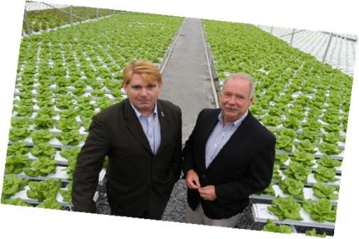
Continental Organics

Slide 48
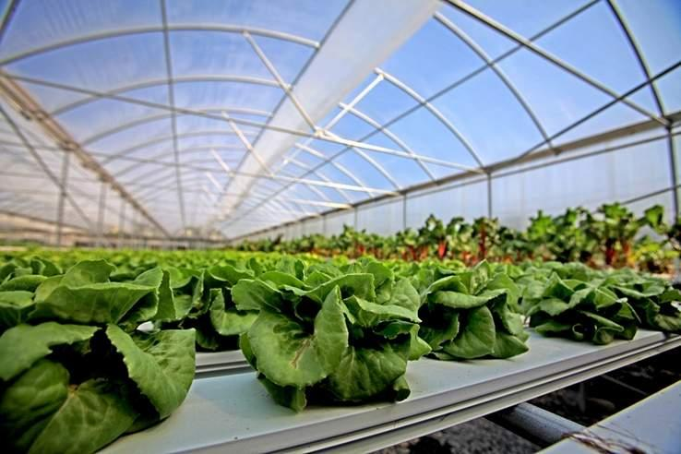
Continental Organics

Slide 49
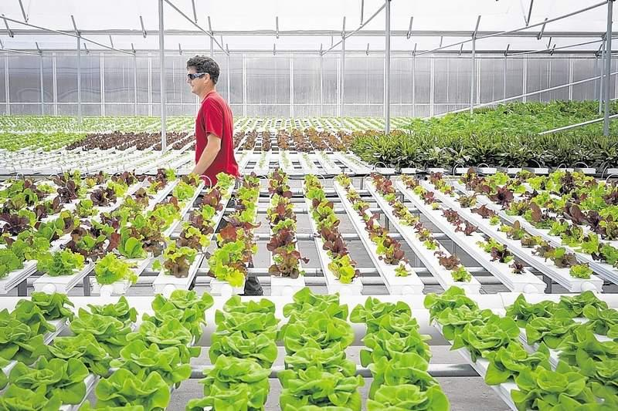
Continental Organics

Slide 50
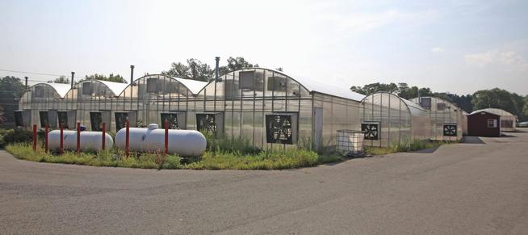
Continental Organics

Slide 51
Continental Organic’s Numbers:
Tilapia production was only 15% of what was planned.
Continental Organics filed for bankruptcy October of 2015 to liquidate assets, including piles of compost and delivery trucks that don’t run. In all, the company listed assets of $2.3 million against liabilities of $9.7 million in documents filed last week with the U.S. Bankruptcy Court.
The company listed additional debts of $1,162,106 to the Small Business Administration, and $750,000 to Empire State Development.
Continental CEO Michael Finnegan invested $3 million of his own money.
Continental lists $2 million worth of greenhouses and fish tanks as part of the $2.3 million of assets , but the tanks and greenhouses were custom-built for the site and might be worthless.
Add these numbers up, and a rough total of $13.5 million went down the drain in this poorly planned and executed venture.
These were experienced business people who simply had no previous experience with profitable aquaponics, and selected poorly-performing technology to use.

